Slide 1

DIGITAL ELECTRONICS
III Semester CSE, CSE (AIML) & CSE (DS)
Dr. Ajit Kumar Patro
DEPARTMENT OF ELECTRONICS AND COMMUNICATION ENGINEERING
SCHOOL OF ENGINEERING & TECHNOLOGY
GIET UNIVERSITY, GUNUPUR, ODISHA

Slide 2
LOGIC LEVELS AND PULSE WAVEFORMS
LOGIC GATES

Slide 3
Logic Levels and Pulse Waveforms
Digital systems use the binary number system. Therefore, two-state devices are used to represent the two binary bits 1 and 0 by two different voltage levels, called HIGH and LOW.
If the HIGH voltage level is used to represent 1 and the LOW voltage level to represent 0, the system is called the positive logic system.
If the HIGH voltage level is used to represent 0 and the LOW voltage level to represent 1, the system is called the negative logic system.

Slide 4
Normally, the binary 0 and 1 are represented by the logic voltage levels 0 V and + 5 V.
In a positive logic system, 1 is represented by + 5 V (HIGH) and 0 is represented by 0 V (LOW).
In a negative logic system, 0 is represented by + 5 V (HIGH) and 1 is represented by 0 V (LOW).

Slide 5
In reality, because of circuit variations, the 0 and 1 would be represented by voltage ranges instead of particular voltage levels.
Usually, any voltage between 0 V and 0.8 V represents the logic 0 and any voltage between 2 V and 5 V represents the logic 1.
The range between 0.8 V and 2 V is called the indeterminate range. If the signal falls between 0.8 V and 2 V, the response is not predictable.

Slide 6
A pulse may be a positive pulse or a negative pulse.
A single positive pulse is generated when a normally LOW voltage goes to its HIGH level and then returns to its normal LOW level.
A single negative pulse is generated when a normally HIGH voltage goes to its LOW level and then returns to its normal HIGH level.

Slide 7
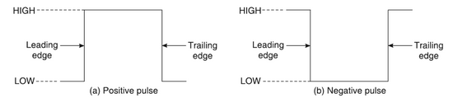

Slide 8
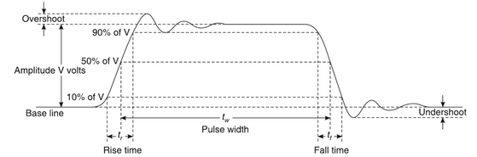

Slide 9
The rise time is defined as the time taken by the pulse to rise from 10% to 90% of the pulse amplitude.
The fall time is defined as the time taken by the pulse to fall from 90% to 10% of the pulse amplitude.
The duration of the pulse is usually indicated by pulse width t_{w} which is defined as the time between the 50% points on the rising and falling edges.

Slide 10
In digital systems the waveforms are composed of a series of pulses and can be classified as periodic waveforms and non-periodic waveforms.
A periodic waveform is one which repeats itself at regular intervals of time called the period, T.
A non-periodic waveform, of course, does not repeat itself at regular intervals and may be composed of pulses of different widths and/or differing time intervals between the pulses.

Slide 11


The reciprocal of the time period is called the frequency of the periodic waveform.
Duty cycle of a periodic pulse waveform is the ratio of the ON time (pulse width t_{w}) to the period of the pulse waveform.

Slide 12


Example: A periodic digital waveform has a pulse width of 25 μs and a period of 150 μs. Determine the frequency and the duty cycle.
Solution:
Pulse width t_{w} = 25 μs and period T = 150 μs
Frequency

Slide 13
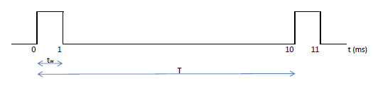

Example: A portion of a periodic digital waveform is shown in Figure. The measurements are in milliseconds. Determine (a) period (b) frequency and (c) duty cycle.
Solution:
Period T = 10 ms

Slide 14
Logic Gates
Logic gates are the basic building blocks of any digital system.
It is an electronic circuit having one or more than one input and only one output.
The relationship between the input and the output is based on a certain logic.
Based on this, logic gates are named as NOT, AND, OR, NAND, NOR, EX-OR and EX-NOR gate.

Slide 15
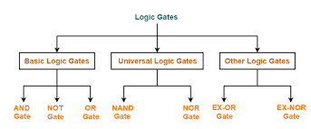
Types of Logic Gates

Slide 16
Buffer
A buffer, is a basic logic gate that passes its input, unchanged, to its output.
The main purpose of a buffer is to regenerate the input, usually using a strong high and a strong low.
A buffer has one input and one output; its output always equals its input.
Its symbol is simply a triangle.
Boolean Expression:

Slide 17


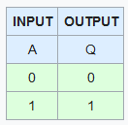
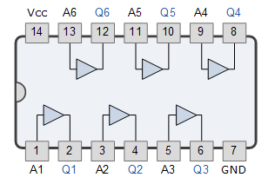
Graphic Symbol
IEEE Symbol
Truth Table
7407 Hex Buffer

Slide 18
NOT Gate
The NOT gate is an electronic circuit that produces an inverted version of the input at its output.
It is also known as an inverter.
If the input variable is A, the inverted output is known as NOT A.
This is also shown as A' or
Boolean Expression:

Slide 19
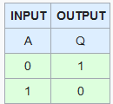


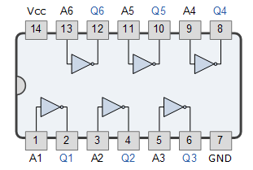
Graphic Symbol
IEEE Symbol
Truth Table
7404 Hex Inverter

Slide 20
AND Gate
The AND gate is an electronic circuit that gives a high output (1) only if all its inputs are high.
A dot (.) is used to show the AND operation.
Boolean Expression:

Slide 21
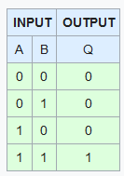


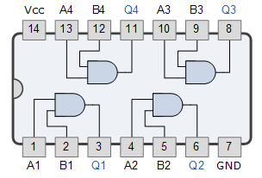
Graphic Symbol
IEEE Symbol
Truth Table
7408 Quad 2-input AND Gate

Slide 22
OR Gate
The OR gate is an electronic circuit that gives a high output (1) if one or more of its inputs are high.
A plus (+) is used to show the OR operation.
Boolean Expression:

Slide 23


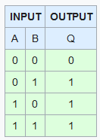
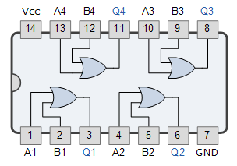
Graphic Symbol
IEEE Symbol
Truth Table
7432 Quad 2-input OR Gate

Slide 24
NAND Gate
This is a NOT-AND gate which is equal to an AND gate followed by a NOT gate.
The outputs of all NAND gates are high if any of the inputs are low.
The symbol is an AND gate with a small circle on the output. The small circle represents inversion.
Boolean Expression:

Slide 25
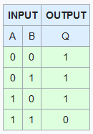


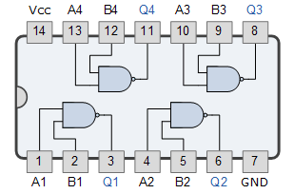
Graphic Symbol
IEEE Symbol
Truth Table
7400 Quad 2-input NAND Gate

Slide 26
NOR Gate
This is a NOT-OR gate which is equal to an OR gate followed by a NOT gate.
The outputs of all NOR gates are low if any of the inputs are high.
The symbol is an OR gate with a small circle on the output. The small circle represents inversion.
Boolean Expression:

Slide 27


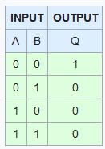
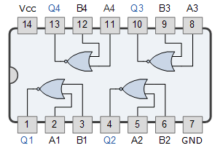
Graphic Symbol
IEEE Symbol
Truth Table
7402 Quad 2-input NOR Gate

Slide 28

EX-OR Gate
The 'Exclusive-OR' gate is a circuit which will give a high output if either, but not both, of its two inputs are high.
An encircled plus sign ( ) is used to show the EX-OR operation.
Boolean Expression:

Slide 29


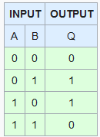
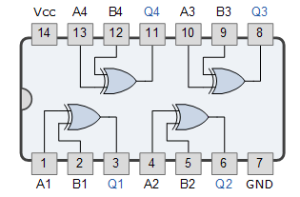
Graphic Symbol
IEEE Symbol
Truth Table
7486 Quad 2-input EX-OR Gate

Slide 30

EX-NOR Gate
The 'Exclusive-NOR' gate circuit does the opposite to the EX-OR gate.
It will give a low output if either, but not both, of its two inputs are high.
The symbol is an EX-OR gate with a small circle on the output. The small circle represents inversion.
Boolean Expression:

Slide 31
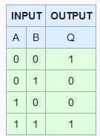


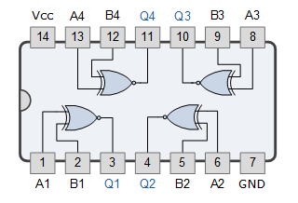
Graphic Symbol
IEEE Symbol
Truth Table
74266 Quad 2-input Ex-NOR Gate

Slide 32
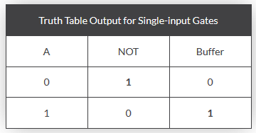
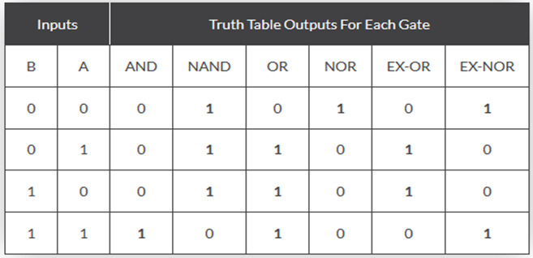
Digital Logic Gate Truth Table Summary

Slide 33
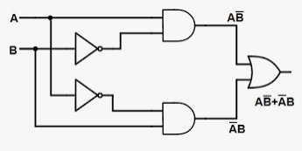
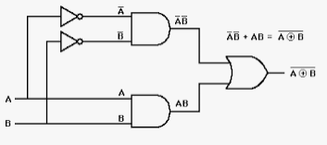
EX-OR Gate
EX-NOR Gate

Slide 34
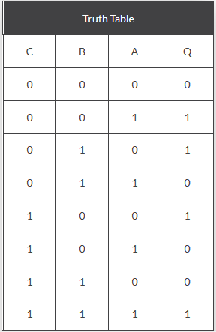
3-input Ex-OR Gate
The logic function implemented by a 2-input Ex-OR is given as either: “A OR B but NOT both” will give an output at Q. In general, an Ex-OR gate will give an output value of logic “1” ONLY when there are an ODD number of 1’s on the inputs to the gate. Then an Ex-OR function with more than two inputs is called an “odd function”.

